Slide 1

Image Processing vs Computer Vision
A Comparative Technical Analysis of Problem Scopes, Algorithmic Foundations, and System Integration
ITA0518 – COMPUTER VISION
Done By
Darani E (192312120)
Visual Computing Technical Review
Slide 1

Slide 2


Executive Overview: Visual Computing
While both disciplines operate on visual data, their operational goals, underlying mathematical paradigms, and output abstraction levels differ fundamentally.
Image Processing (IP)
Computer Vision (CV)
Low to Mid-Level Signal Transformation
High-Level Semantic Interpretation
•
Primary Objective: Manipulate pixel values to enhance quality, suppress noise, or highlight features.
•
Primary Objective: Reconstruct 3D structure and derive automated decisions from visual inputs.
•
Transformation Mapping: Mapping an input image to an updated output image .
•
Transformation Mapping: Mapping visual input to semantic labels or geometric models.
•
Core Paradigms: Spatial filtering, Fourier transforms, histogram equalization, and wavelets.
•
Core Paradigms: Convolutional Neural Networks, Transformer backbones, tracking, and pose estimation.
•
Domain Boundary: Processed result remains a visual image or feature map.
•
Domain Boundary: Result is actionable data, classifications, bounding boxes, or spatial coordinates.

Slide 3
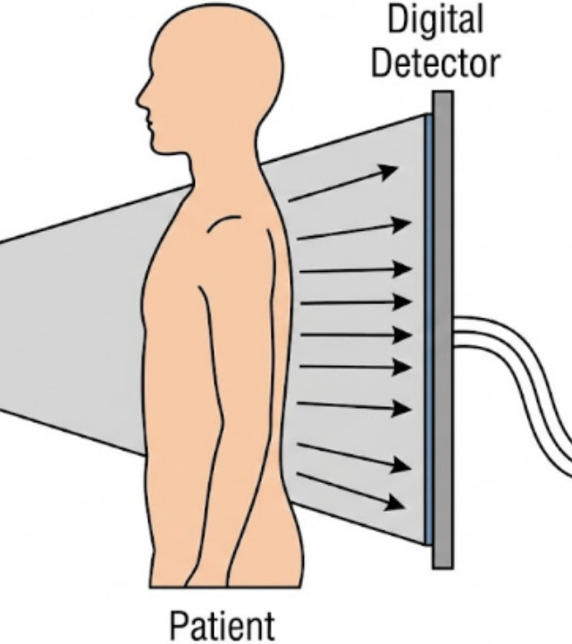



Scope: Image Processing Domain
Determinism & Signal Conditioning
Image processing focuses on deterministic transformations applied to multi-dimensional signals to improve visual fidelity or highlight latent structural properties.
Mathematical Formalism: Spatial Filtering
< mi>
•
Denoising & Smoothing: Gaussian blur, Median filtering, Bilateral filtering.
•
Contrast Enhancement: Histogram equalization, CLAHE, gamma correction.
•
Frequency Domain: Low-pass, High-pass, and Band-pass Butterworth filtering.

Slide 4

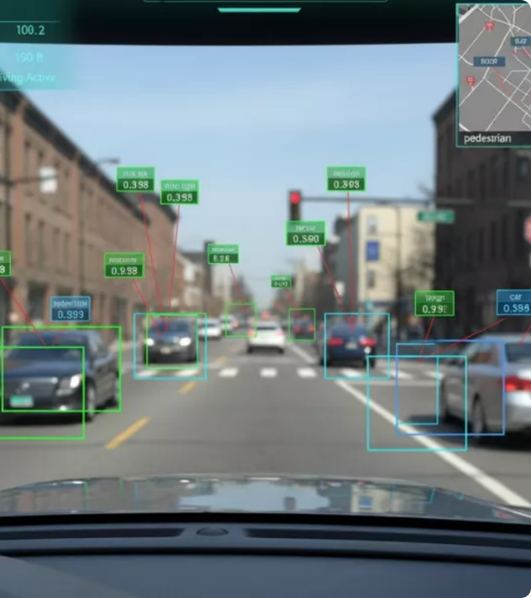

Scope: Computer Vision Domain
Cognition & Semantic Perception
Computer vision mimics human perception by bridging raw sensory data with contextual semantics, enabling automated decision-making and spatial reasoning.
Deep Learning Formulation: Object Detection
•
Object Detection & Recognition: YOLO, Faster R-CNN, SSD architectures.
•
Semantic & Instance Segmentation: Mask R-CNN, Segment Anything Model (SAM).
•
3D Reconstruction & SLAM: Stereo vision, Structure-from-Motion (SfM).

Slide 5










Technical Pipeline Comparison
Comparing the execution pipelines demonstrates how Image Processing feeds directly into Computer Vision architectures.
Classical Image Processing Pipeline (Deterministic)
1. Raw Acquisition
2. Pre-processing
3. Enhancement
4. Output Image
Sensors / CCD Capture
Noise Removal & Gamma
Sharpening & Contrast
Refined Matrix
Modern Computer Vision Pipeline (Probabilistic / AI)
1. IP Pre-processing
2. Feature Extraction
3. Semantic Inference
4. Decision Output
Normalization & Resizing
Convolutional Backbones
Attention / Deep Heads
Metadata / Action Vector
Visual Computing Technical Review
Slide 5

Slide 6




Algorithmic & Math Foundations
Image Processing Mathematics
Computer Vision Mathematics
Focuses on linear algebra, calculus, and discrete signal processing algorithms.
Rooted in statistical optimization, multi-view geometry, and neural learning.
•
Discrete Fourier Transforms (DFT): Frequency domain analysis and filtering.
•
Epipolar Geometry: Fundamental Matrix ( ) and Essential Matrix ( ).
•
Backpropagation & Optimization: Stochastic Gradient Descent (SGD), AdamW optimizer.
•
Convolution Kernels: Sobel ( ), Laplacian of Gaussian (LoG), Canny filter.
•
Probabilistic Graphical Models: Markov Random Fields (MRF), Kalman Filtering for tracking.
•
Morphological Operators: Dilation, erosion, opening, closing matrix transformations.
Visual Computing Technical Review
Slide 6

Slide 7

Comprehensive Comparative Matrix
Comparison Dimension | Image Processing | Computer Vision
Input Data | Raw 2D / 3D Images or Video Frames | Processed Images, Video Streams, Point Clouds
Output Data | Modified / Enhanced Image Matrix | Labels, Bounding Boxes, 3D Mesh, Decision Actions
Primary Goal | Signal Enhancement & Feature Extraction | Visual Perception, Understanding & Automation
Core Methodologies | Spatial & Frequency Domain Filters, Wavelets | Convolutional Networks, Vision Transformers, Graph Neural Networks
Human Visual Analogy | Retinal Signal Conditioning / Optic Nerve Processing | Visual Cortex Cognition & High-Level Brain Interpretation
Computational Focus | Pixel-level operations, Deterministic DSP | Pattern recognition, High-dimensional optimization, Inference
Visual Computing Technical Review
Slide 7

Slide 8




Real-World Industry Applications
Healthcare
Automotive
Manufacturing
Security
Medical Imaging
Autonomous ADAS
Quality Assurance
Surveillance Systems
IP: Contrast tuning on CT/MRI scans to highlight soft tissue boundaries.
IP: High Dynamic Range (HDR) blending under tunnel glare.
IP: Edge detection for PCB trace continuity measurement.
IP: Night-vision infrared thermal image dehazing.
CV: Automated tumor segmentation and metastasis trajectory prediction.
CV: Real-time pedestrian detection, lane tracking, and path planning.
CV: Anomaly detection using generative autoencoders on production lines.
CV: Facial identification and crowd behavior anomaly recognition.
Visual Computing Technical Review
Slide 9

Slide 9


Hardware & Compute Architecture
Image Processing Hardware
Computer Vision Hardware
Streamed Pixel Processing Hardware
High-Throughput Parallel Compute
•
DSPs & FPGAs: Fixed-function pipelines optimized for low-latency matrix convolution.
•
GPUs & Tensor Processing Units (TPUs): Optimized for dense matrix multiplication and parallel tensor operations.
•
Image Signal Processors (ISPs): Dedicated silicon blocks inside camera modules for demosaicing, auto-exposure, and white balance.
•
Neural Processing Units (NPUs): Specialized edge AI accelerators (e.g., Apple Neural Engine, Qualcomm Hexagon).
•
Memory Bottlenecks: High memory bandwidth requirement for model parameters and feature activation maps.
•
Memory Bottlenecks: Low cache requirements; operates linearly on streaming pixel rows.
Visual Computing Technical Review
Slide 10

Slide 10


Summary & Conclusions
Key Takeaways for System Engineers & Researchers
Complementary Fields
Compute Trade-offs
End-to-End Synergy
IP and CV are not mutually exclusive; IP refines signal inputs while CV infers high-level semantics.
Deterministic IP runs efficiently on lightweight edge DSPs; CV requires deep parallel accelerators.
Modern industrial systems combine hardware-level ISP filtering with deep neural inference heads.
Questions & Discussion
Visual Computing Technical Review
Slide 12

